Slide 1
The Atlantic
Multidecadal Oscillation
Lefebvre Louis, Kouassi Cyrille, Subramani Venkatesh & Salou Emmanuelle
Notes:
6 minutes par personnes !

Slide 2
The Atlantic Multidecadal Oscillation
Introduction : What is the AMO and how to derive its index ?
I- Exploration of the scenario = ssp245 & ssp585.
II- Evolution of the spatial pattern
Conclusion

Slide 3
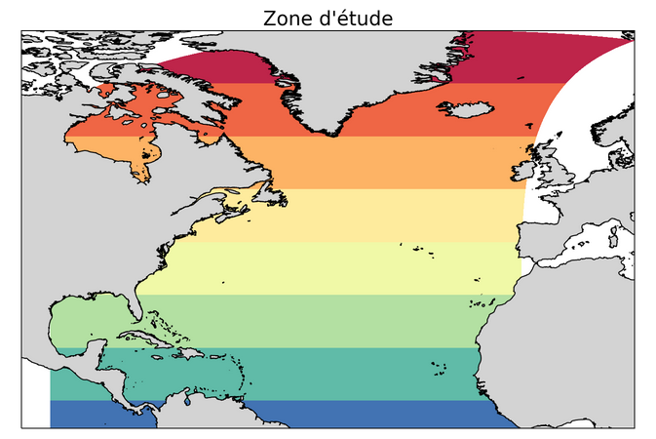
Introduction : What is the AMO and how to derive the AMO Index ?
What is the AMO ?
- long-duration changes in the sea surface temperature of the North Atlantic Ocean
- phase : 20-40 years
- amplitude : 1°C
- area : (cf map) 80°W → 0°E
0°N → 65°N
- linked to the thermohaline
circulation

Slide 4
Introduction : What is the AMO and how to derive it ?
Why it is important ?
It is correlated with
hurricane activity
North American & European summer climate
Arctic sea ice anomalies
To understand the climate variability

Slide 5
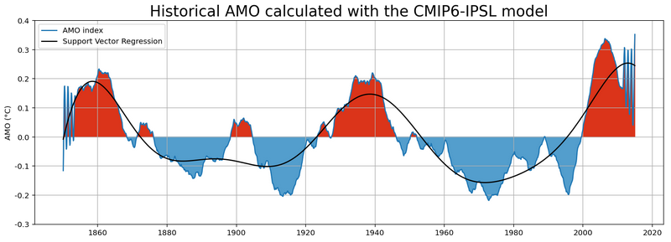
Data : historic monthly-mean SST from IPSL
How to derive the AMO ?
We select monthly-mean SST anomaly
To highlight the variability : we remove the linear trend
To smooth the AMO : 10 years rolling average

Slide 6
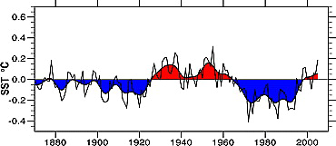
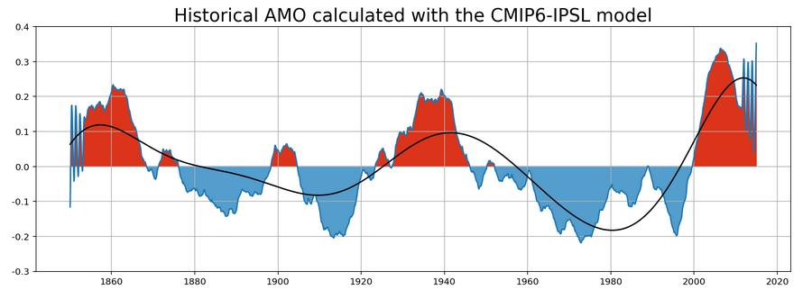
Historical Amo calculated in the article
Validation of our results by comparison of :
the AMO index calculated in the article “ Atlantic hurricanes and natural variability in 2005” Kevin E. Trenberth and Dennis J. Shea
the historic AMO index we derived

Slide 7
Exploration of the ssp245 & ssp585
Applicability: How does the 5 V’s apply here ?
Tightly-linked
Volume : 100s of GBs Data
Value : Directly affects creatures on Earth
Loosely-linked
Veracity : Not necessarily without abnormalities
Velocity : Sampling frequency
Variety : Structured (but different way of organisation)

Slide 8
Challenges and Solutions
Goal: Import ~ 20 simulations data upon filtering North Atlantic Region
Challenges | Solutions
Variable names change across dataset | Handpick what is coherent
2. Data Storage method changes | Handpick where lat & lon are separate
3. Inconsistent frequency of samples | Interpolate
4. Order of master dataset changes | Export the AMO result to CSV
5. Temperature unit disparity | Kelvin - Celsius conversion

Slide 9
Seasonality and Trends - Its impact
What do these mean ?
Seasonality : Time-dependent and recurring
Trend : Changes over time and not time-dependent & recurring
What do these mean to forecast while modeling ?
High Variance, anomalies
How to handle ?
Differencing
Modeling

Slide 10
Modeling (Polyfit)
How does it do?
A = original signal
Step 1 : Fit A to get to know the coefficients
Step 2 : Simulate the annual seasonal pattern (B) using coefficients
Step 3 : Filter = A - B
Filter = the seasonal impact gets subtracted.

Slide 11
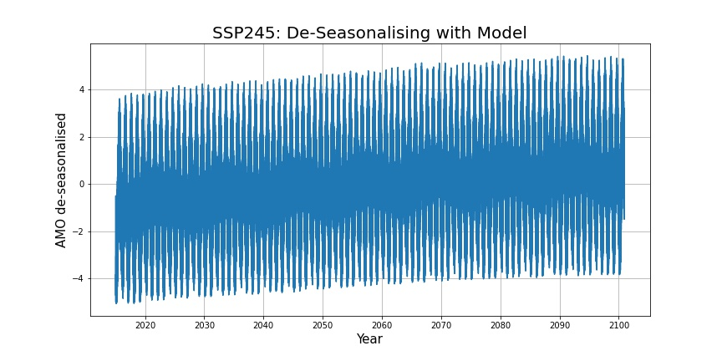
Results (Polyfit)

Slide 12
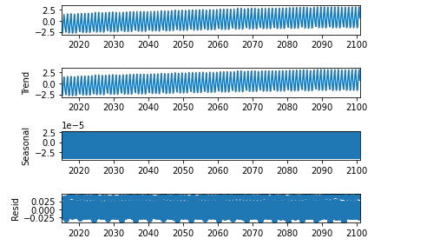
Seasonality and Trends
1 - Decompose times series
2 - To learn about the seasonality of our series let's plot Moving average for 12 months and 10 years
3 - Dealing with stationarity(Dickey–Fuller test)
4- Remove seasonality
5-Remove linear trends

Slide 13
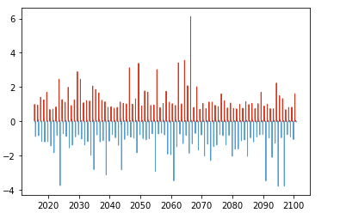
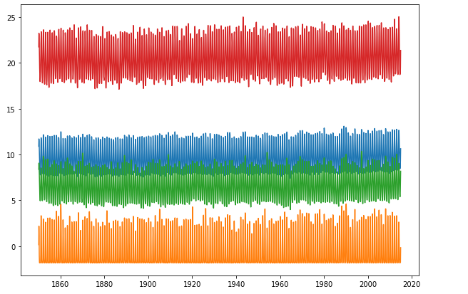
Results
Q25, Q75, Q50, mean
AMO_index SSP245

Slide 14
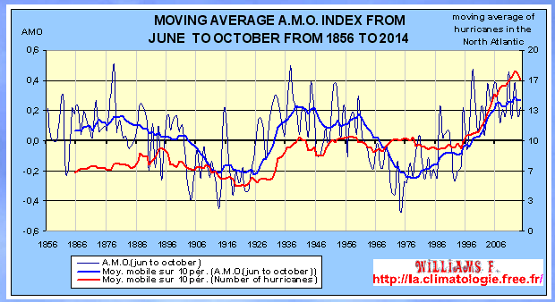
Conclusion & What’s next
Even after removing seasonality and trend, the signal is not smooth. (May be interpolating large chunk of data comes into play ?)
Use the dataset without being interpolated.
find correlation between AMO and hurricanes
extract from : http://la.climatologie.free.fr/enso/enso-pdo3.htm

Slide 15
Spatial pattern of variability : The Method
Data :
Institution : IPSL
Scenario: ssp126, ssp245 & ssp585
Time span: 2015 - 2100
Method : CPA of the detrended and 10 years rolling averaged SST anomaly

Slide 16
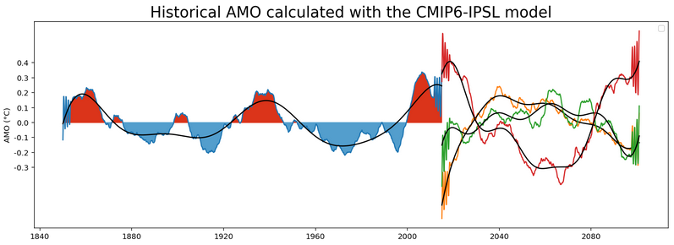
Spatial pattern of variability : The Method
Scenario: ssp126, ssp245 & ssp585
ssp 126
ssp 245
ssp 585

Slide 17
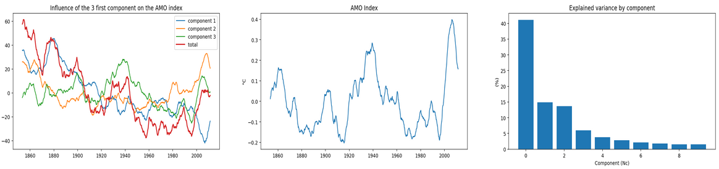
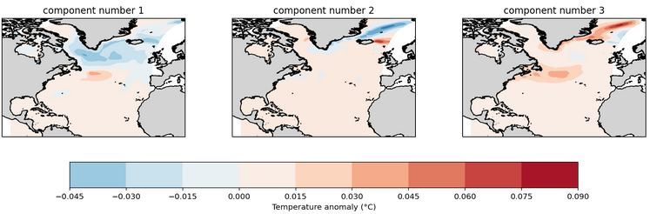
Spatial pattern of variability : historique

Slide 18
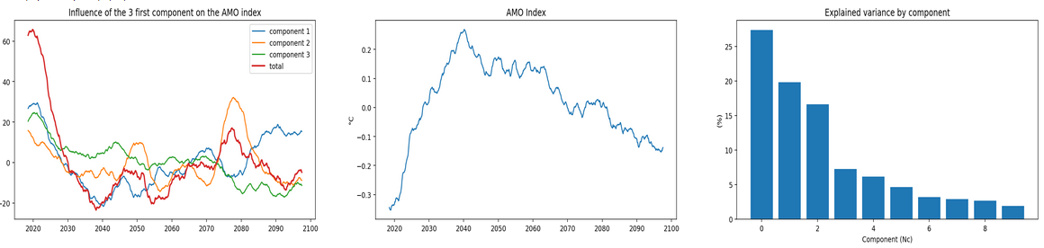
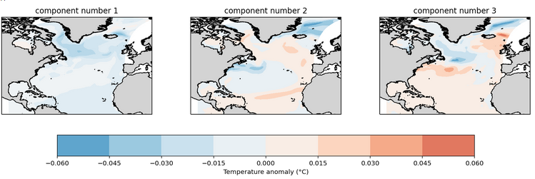
Spatial pattern of variability : ssp 126

Slide 19
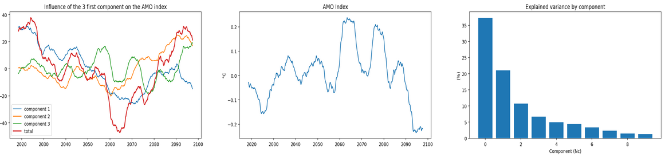
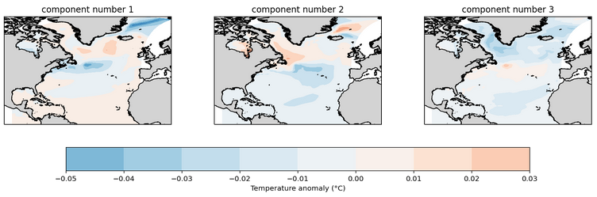
Spatial pattern of variability : ssp 245

Slide 20
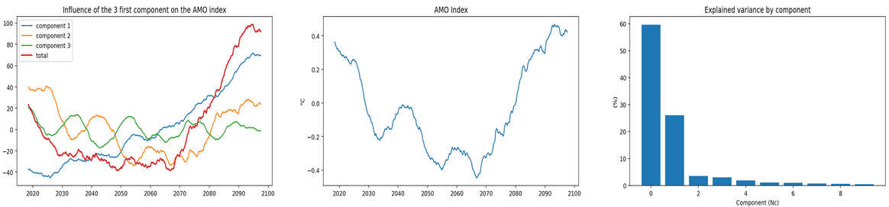
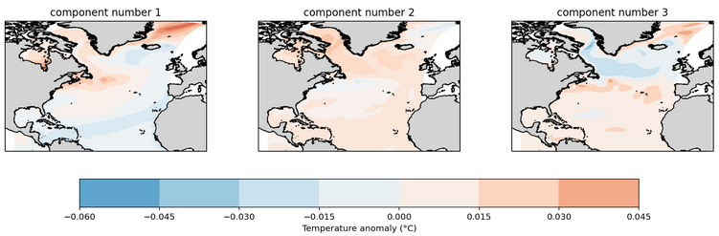
Spatial pattern of variability : ssp 585

Slide 21
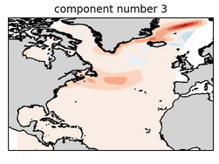
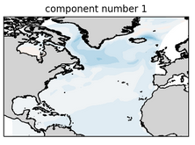
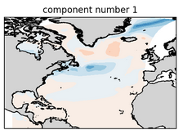
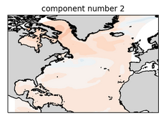
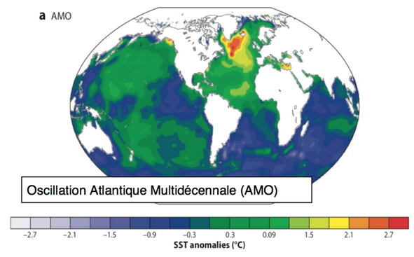
Comparison
Historic
SSP 126
SSP 245
SSP 585

Slide 22
Sources
1-https://www.aoml.noaa.gov/phod/d2m_shift/amo_faq.php
2-https://agupubs.onlinelibrary.wiley.com/doi/10.1029/2006GL026894
3-http://www.sorbonne-universites.fr/publics/presse/nos-experts-dans-les-medias/prevoir-les-changements-climatiques-a-10-ans-le-nouveau-defi-des-climatologues.html

